Slide 1
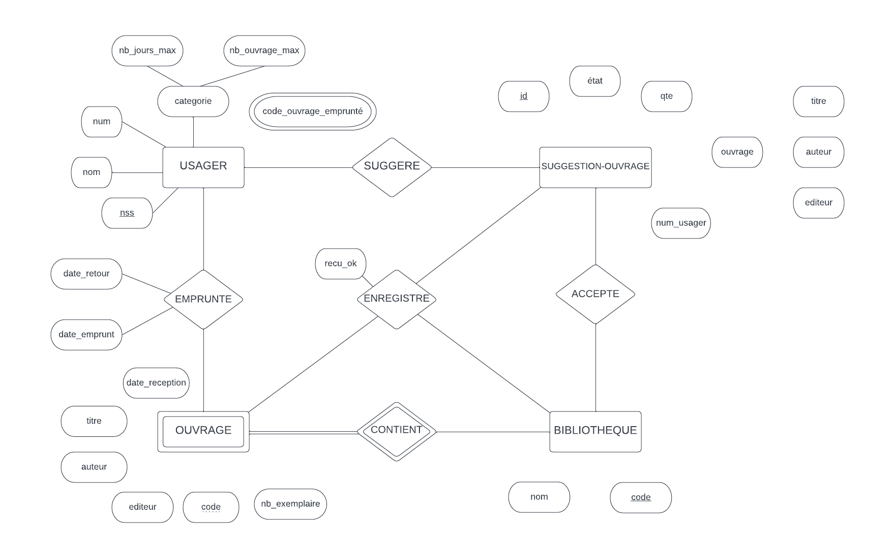
M
N
M
N
M
N
1
N
1
N
1

